Slide 1

Using CDBG for Economic Development
February 5, 2026
Beth Ulrich, Grant Program Administrator, Saint Paul, MN (Moderator)
Jessica Deegan, Grants Compliance Manager, Saint Paul, MN
Heather Royall, Deputy Director, Salt Lake City, UT

Slide 2

Agenda
1. Introductions
2. Overview and National Objectives
3. Eligible Activities/Matrix Codes
4. City of Saint Paul Program and Project Examples
5. Salt Lake City Program
6. Questions

Slide 3
Overview of CDBG National Objectives
Under the Community Development Block Grant (CDBG) program, every funded activity (excluding planning and administrative costs) must meet one of three National Objectives as mandated by the U.S. Department of Housing and Urban Development (HUD).
1. Benefit Low- and Moderate-Income (LMI) Persons
2. Prevention or Elimination of Slums or Blight
3. Meet Urgent Community Development Needs

Slide 4
CDBG National Objectives
1. Benefit Low- and Moderate-Income (LMI) Persons
Area Benefit: Activities providing benefits to all residents in a specific, primarily residential area where at least 51% of residents are LMI.
Limited Clientele: Activities benefiting a specific group of people, at least 51% of whom are LMI (homeless shelters, senior centers, or services for persons with disabilities).
Job Creation or Retention: Economic development activities that create or retain permanent jobs, where at least 51% of those jobs are held by or made available to LMI persons.

Slide 5
CDBG National Objectives
2. Prevention or Elimination of Slum and Blight
Area Basis: Activities that address one or more conditions contributing to the deterioration of a designated slum or blighted area.
Spot Basis: Activities strictly limited to eliminating specific conditions of blight or physical decay outside a designated blighted area (e.g. demo of a single dilapidated, hazardous building)
Urban Renewal: Activities necessary to complete an existing urban renewal plan initiated under previous federal law.

Slide 6
CDBG National Objectives
3. Meet Urgent Community Development Needs
Criteria: The conditions must be of recent origin or have recently become urgent (typically within the last 18 months).
Funding Limitation: The grantee must certify that it is unable to finance the activity on its own and that other sources of funding are not available.
Examples: Typical uses include disaster response for events like floods, tornadoes, or immediate public health crises.

Slide 7
National Objectives met by Economic Development Activities: Job Creation or Retention Requirements
Businesses must commit to making 51% of new jobs or retained jobs available to LMI persons.
Only permanent jobs count; temporary or seasonal jobs typically do not qualify unless they are the employee's primary occupation.
No substantial prior training or education (beyond high school) is required.
If jobs are not filled by LMI persons, must prove they were "made available" by showing LMI persons received first consideration (through targeted recruitment).
Job Retention: Requires proof jobs would be lost without aid At least 51% of the retained jobs must currently be held by LMI persons, OR commitment that the jobs will turn over to LMI persons within two years.
CDBG assistance cannot exceed an average of $35,000 per FTE job (full-time equivalent basis).

Slide 8
National Objectives met by Economic Development Activities: Area Benefit (Service Area) Requirements
The service area must be primarily residential.
At least 51% of the residents in the defined service area must be low- to moderate- income persons.
Grantees must identify the specific boundaries based on the business's actual
reach. (demonstrated through business plan or customer address collection)
Documentation must include census tract or districts, total population, and the number of LMI persons residing within those boundaries.

Slide 9
Ineligible Activities
Buildings for the general operation of government
Political activities
Equipment, personal property, fixtures, furnishings*
Motor vehicles*
Operating and maintenance expenses
Income payments
*Exceptions: Equipment when permanently affixed or leased for construction
Motor vehicles when necessary to carry out activity (specialty)

Slide 10
Eligible Economic Development Activities [Title 1 of Housing and Community Development Act]
Commercial rehabilitation [105(a)(4)]
Special economic development activities [105(a)(14) and 105(a)(17)]
Microenterprise activities [105(a)(22)]
Public facilities [105(a)(2)]
Public services [105(a)(8)]

Slide 11
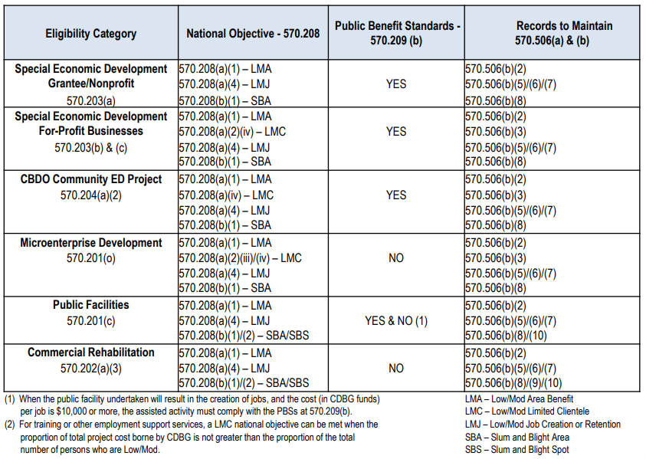
Eligible Economic Development Activities [Regulatory References 24 CFR 270]

Slide 12
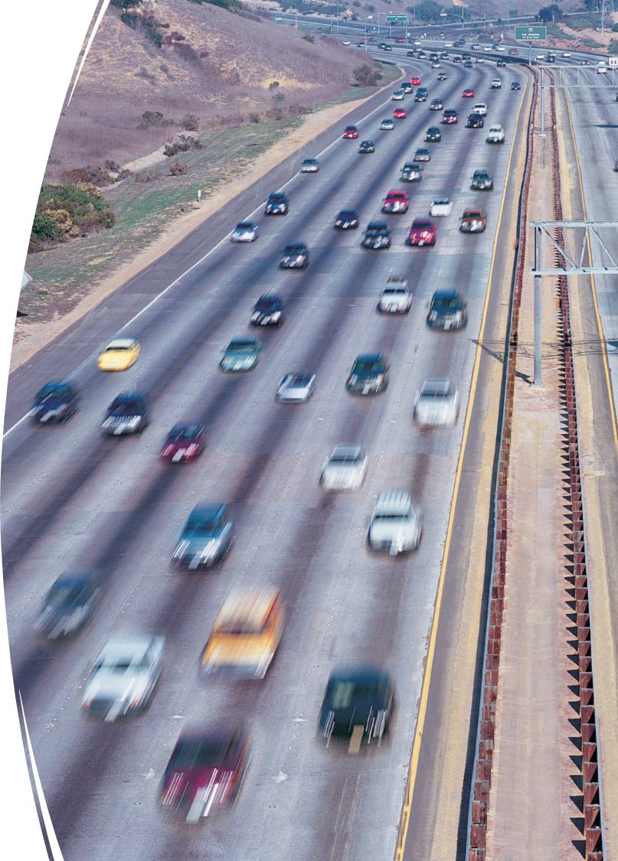
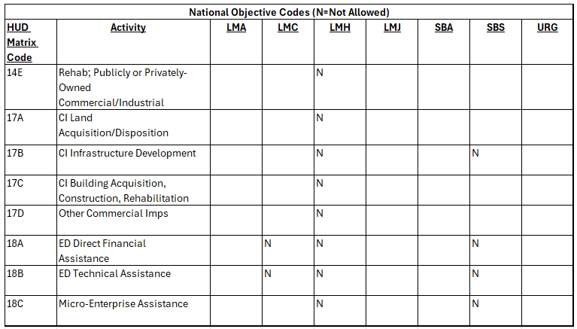
Eligible Activities and Matrix Codes

Slide 13
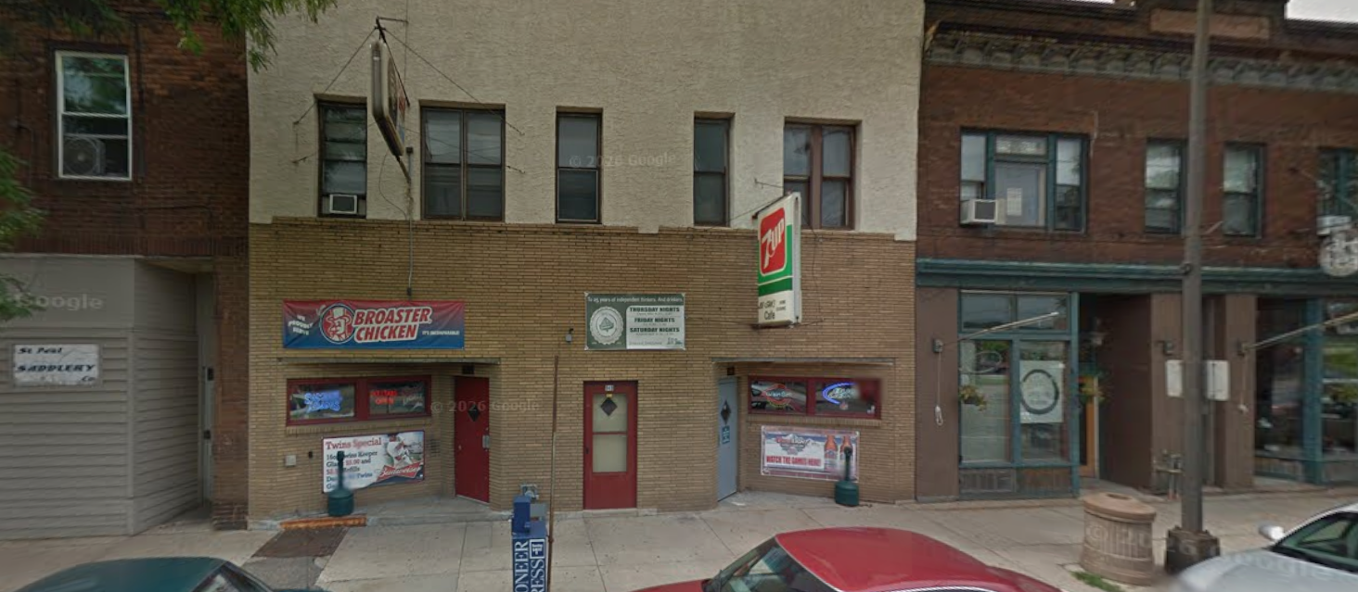
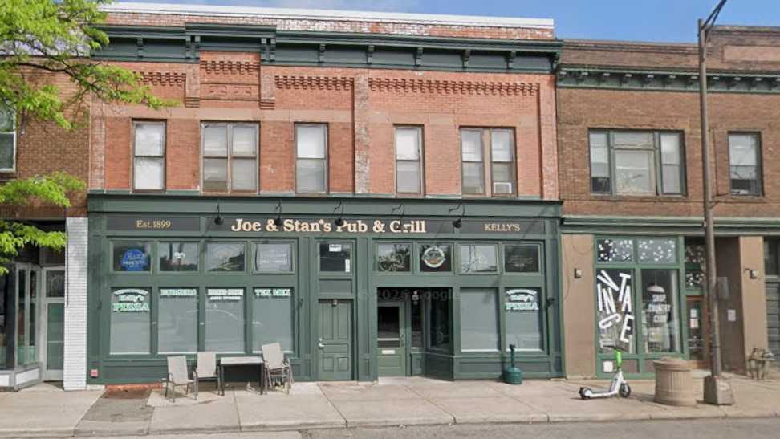
Commercial Rehabilitation (14E)
Rehabilitation of publicly or privately-owned commercial/industrial buildings, limited to
Façade improvements
Corrections of code violations
Not subject to public benefit standard 570.202(a)(3)
Before
After

Slide 14
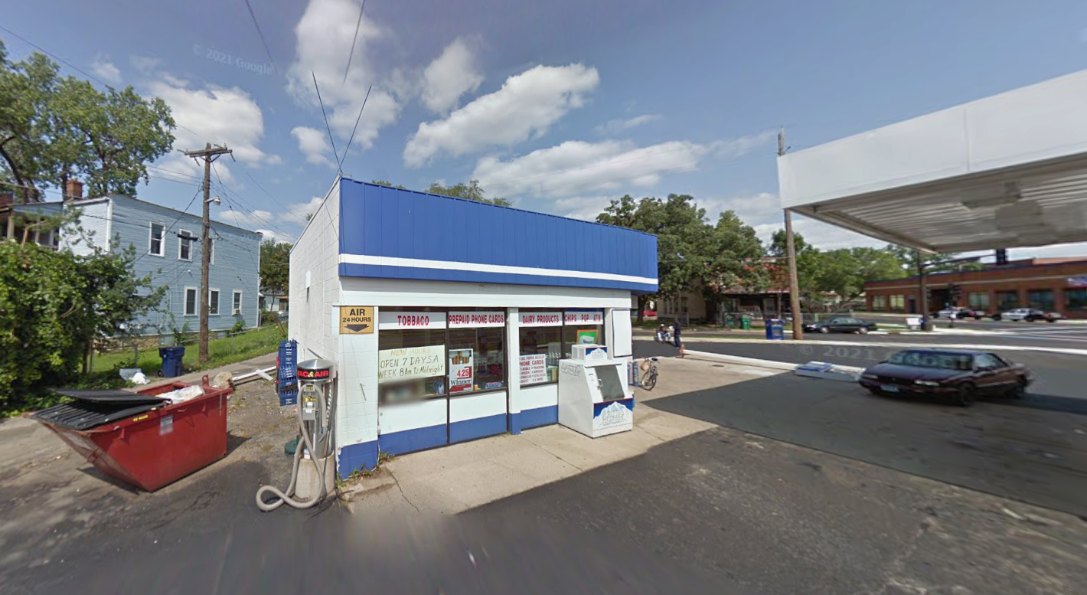
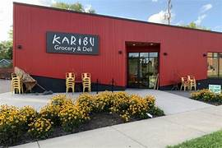
Special Economic Development Activities (18A)
For-Profit Assistance
Grants, loans, loan guarantees, technical assistance
Recipient or Subrecipient Activities:
Acquisition, construction, rehabilitation, reconstruction, installation of other related real property equipment or improvements
Triggers:
Underwriting
Public Benefit Standards
Before
After

Slide 15
Microenterprise Assistance (18C)
For-profit business with 5 or less employees (inc. owner)
Direct financial assistance
Technical Assistance
No limit on amount or type of assistance to microenterprise
Not subject to public benefit under 570.201(o)
Owner not required to be LMI but must meet national objective

Slide 16
Job Training
Involves building skills for employees or potential employees. Can be undertaken as part of:
Public Service [570.201(e)]
Special Economic Development [570.203(c)]
Micro-Enterprise Activity [570.201(o)]
Eligible CBDO Activity [570.204] - not subject to
public services cap

Slide 17
Underwriting Guidelines
Required for activities eligible under 570.203 and CBDO activities under 570.204 carrying out like activities. Six required criteria include
Project costs are reasonable
All sources of project financing are committed
CDBG funds are not substituted for non-federal financial support
Project is financially feasible
Return of owners equity investment is not unreasonably high
CDBG funds to be disbursed on pro-rata basis

Slide 18
Public Benefit Standards
Required standards to evaluate public benefit provided for special economic development activities per 570.209(b)
 | Individual Standards (project level) | Aggregate Standards (portfolio level)
Scope | Applied to each individual project | Applied to the total of all projects in program year
Job Creation/Retention | Max $50,000 CDBG per FTE job | Average of $35,000 CDBG per FTE job
Service Area (residents) | Max $1,000 CDBG per LMI person served | Average of $350 CDBG per LMI person served
Timing | Evaluated at time funds are obligated | Evaluated annually for all projects obligated in that year
Non-Compliance | Project must be modified or funding repaid | Grantee must meet standard across portfolio

Slide 19
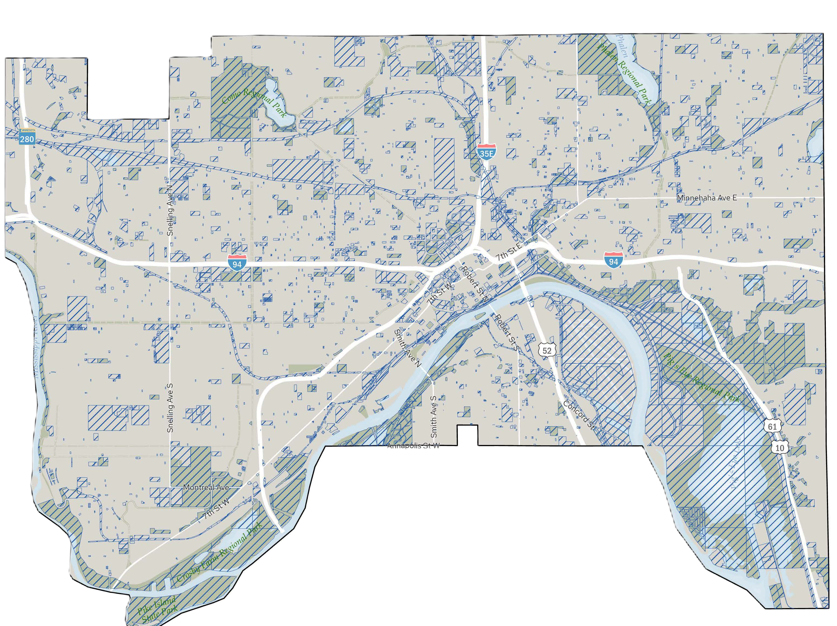
City of Saint Paul
Home of Snoopy, the Post-it Note, and Two-Time Walter Cup PWHL Winners…the MN Frost
Capital City, pop = 311,527 (2020)
Smaller half of the “Twin Cities” at 56 sq. miles
16 sq. miles of non-taxable land
Over 160 parks consuming 4,000 acres
100 miles of trails
14 colleges and universities
City with the most shoreline on the Mississippi at 26 linear miles
Originally inhabited by Sioux and Ojibwe peoples
Currently more than 114 languages spoken at Saint Paul schools
2025 HUD Allocations:
CDBG = $6,756,518
HOME = $1,423,385
ESG = $594,589

Slide 20
Programs and Projects in St Paul
 | Program | Project
Activity Delivery & Management | Subrecipient Program – Written Agreement with subrecipient. City grants specialist manages subrecipient contract. | Business/project funded directly by grantee - Written Agreement with business/entity. City project manager oversees project.
Examples of Activities | Commercial Rehabilitation Program Façade Improvements and Code Corrections | Special Economic Development Activities Public Facilities
Considerations | Community Based Development Organizations Neighborhood Revitalization Strategy Areas Monitoring and Oversight Underwriting and Public Benefit Standards

Slide 21

Program Example: East Side Neighborhood Development Company’s Business Investment Fund
Program Details:
Program awarded through competitive Capital Improvement Budget Process
Assists small businesses in determining eligibility and provide technical assistance for façade improvements and code remediation
Projects include new storefront windows, exterior paint or murals, replacement or restoration of brick, new awning, lighting, signage, doors, and entry ways, as well as code correction required activities
Provides loans up to $50,000
National Objectives Met: Low/Mod Jobs, Area Benefit
Matrix Code: Primarily 14E, Rehab; Publicly or Privately-Owned Commercial/Industrial

Slide 22
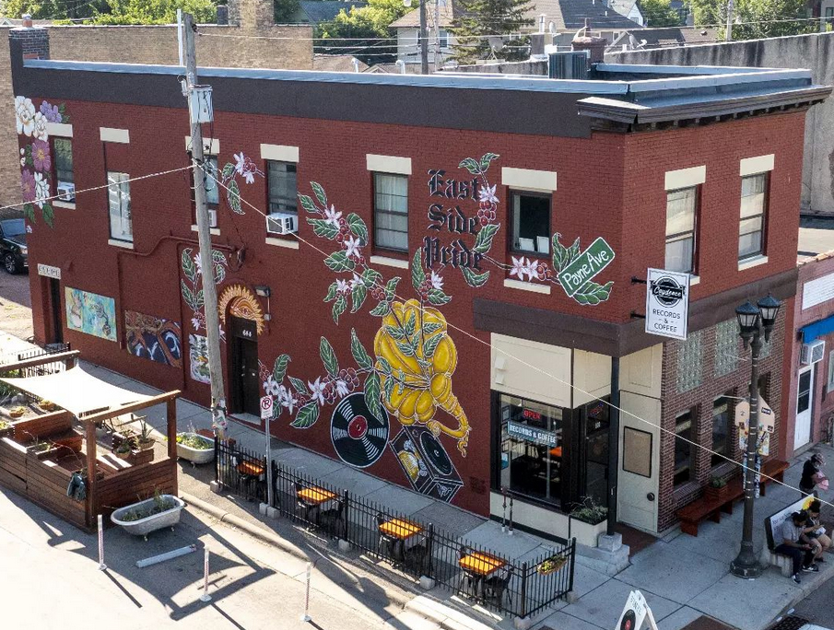
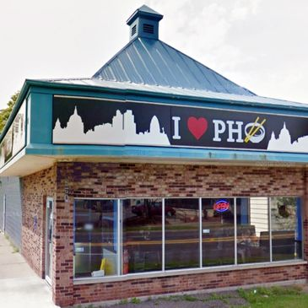
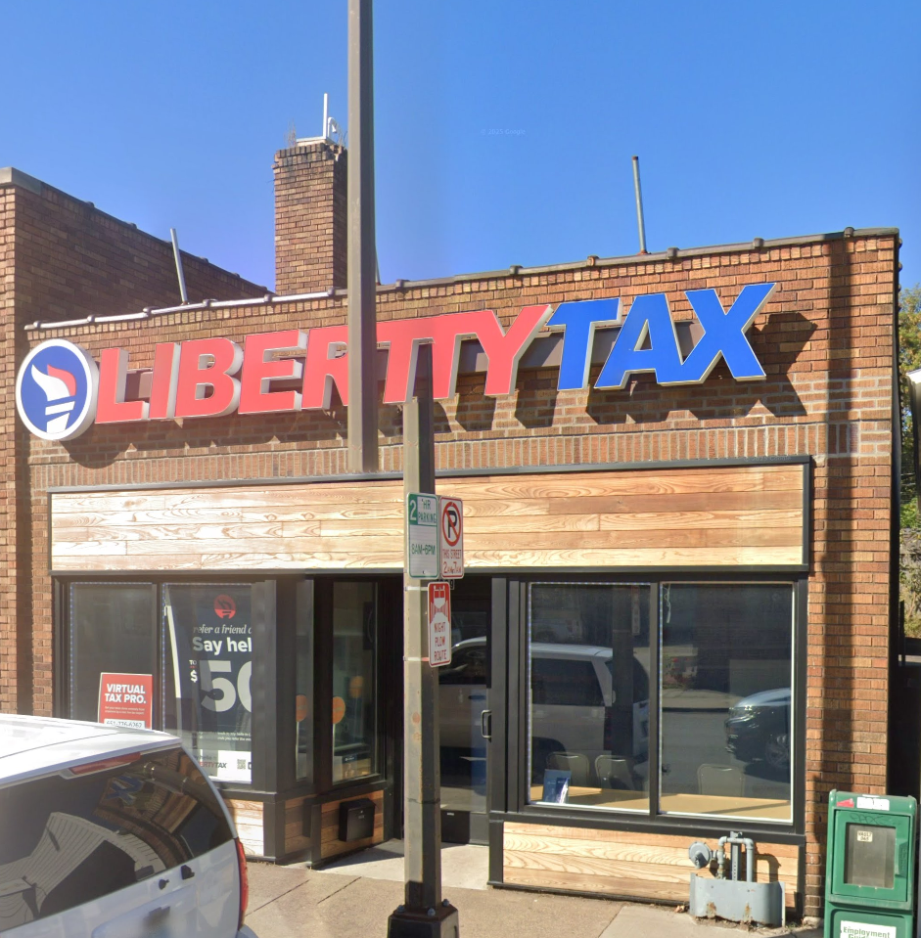
Program Example: East Side Neighborhood Development Company’s Business Investment Fund
Awarded nearly $1,000,000 over last five years 2021-2025 with 19 projects completed or now open, and several projects in the pipeline.
Has been a CDBG subrecipient since 1994.

Slide 23
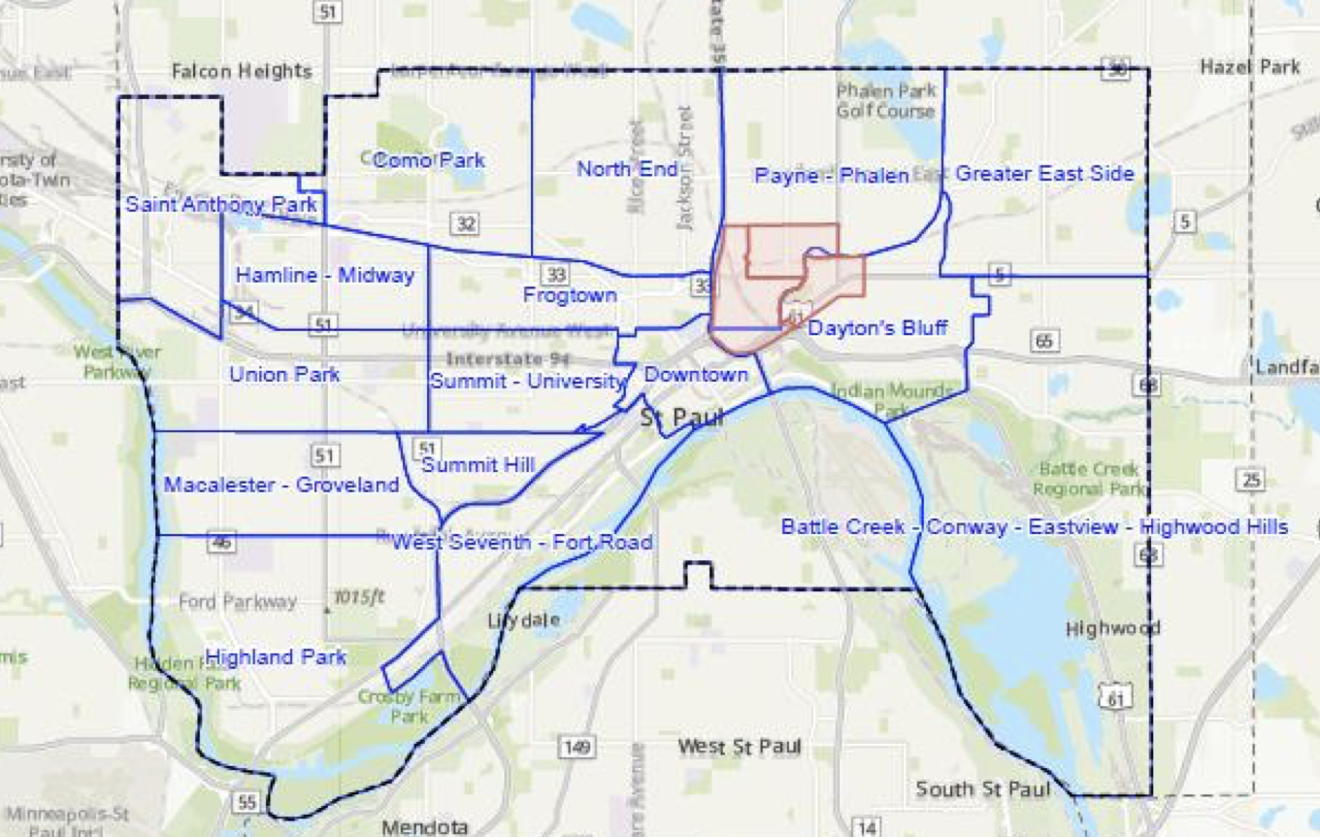
Other Program Considerations
Provide Technical Assistance and Capacity Building
including peer learning among other subrecipients
Subrecipient Monitoring
Follow 2 CFR 200 Subpart F
Community Based Development Organizations
Options and Flexibilities
Neighborhood Strategy Revitalization Areas
ESNDC area has a current NRSA (see map)

Slide 24
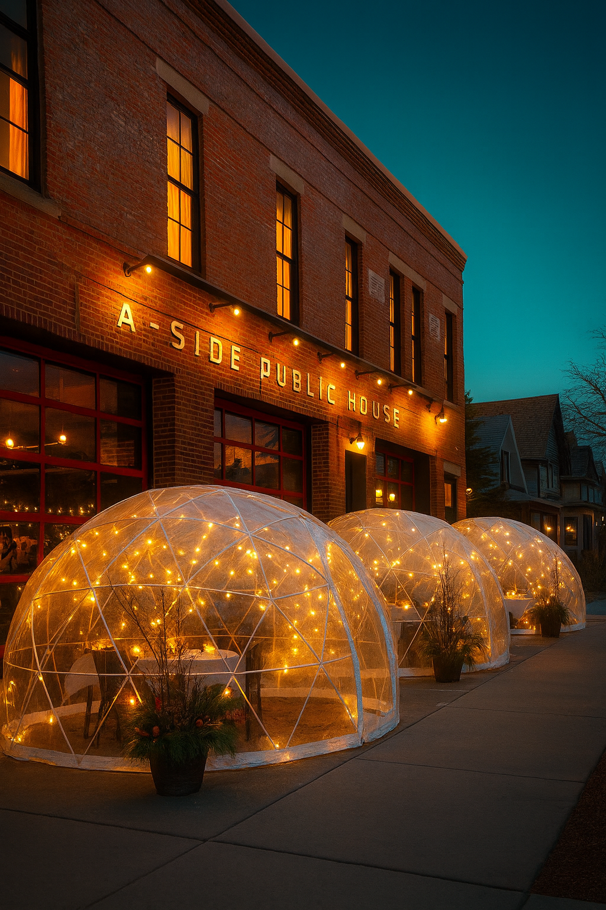
Project Example: A-Side Public House
National Objective Met: Low/Mod Jobs (6)
Matrix Code: 14E – Rehabilitation: Publicly or Privately Owned Commercial/Industrial
Project Details:
New restaurant completed in 2020
adaptive reuse of fire station
$200,000 in CDBG no other sources
Project managed by City Project Manager

Slide 25
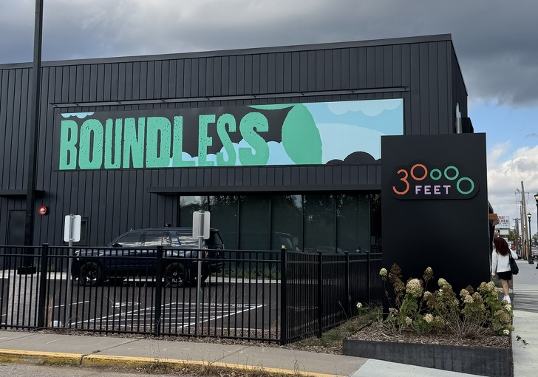
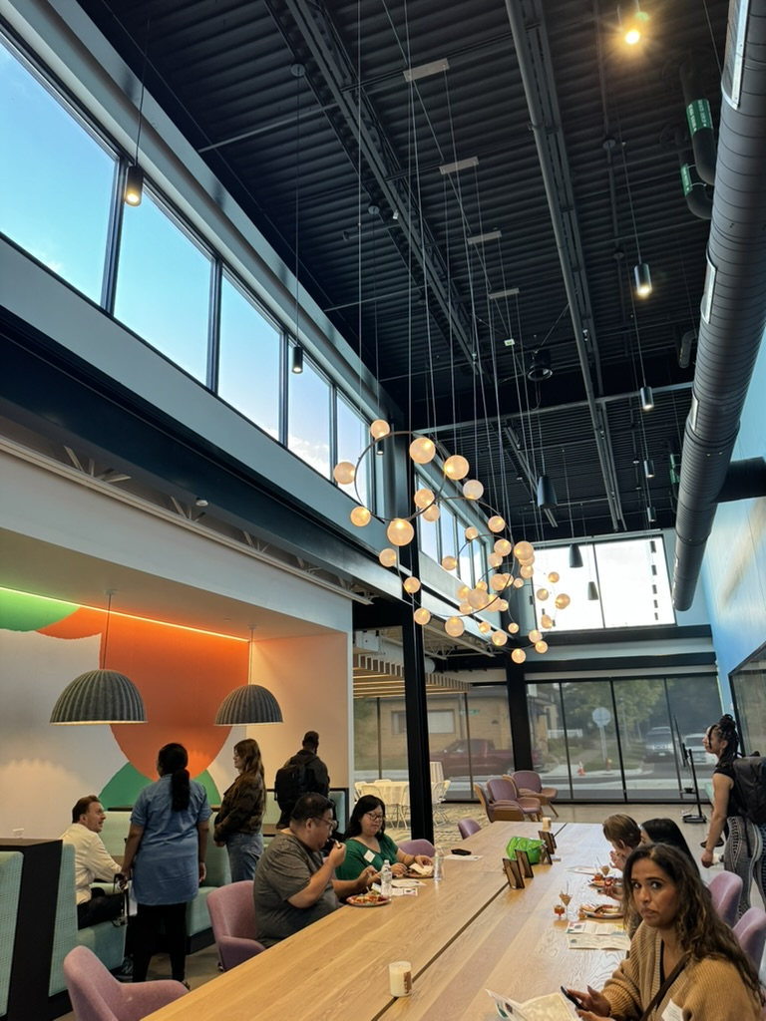
Project Example: 30,000 Feet
National Objective Met: Low/Mod Limited Clientele
Matrix Code: 17C – CI Building Acquisition, Construction, Rehab
Project Details:
Phase II of Construction of Arts and Tech center serving Saint Paul Youth from nearby schools completed 2025
$420,000 CDBG $304,840 private
LMC achieved through Nature/Location (low income school population)

Slide 26
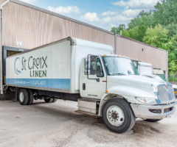
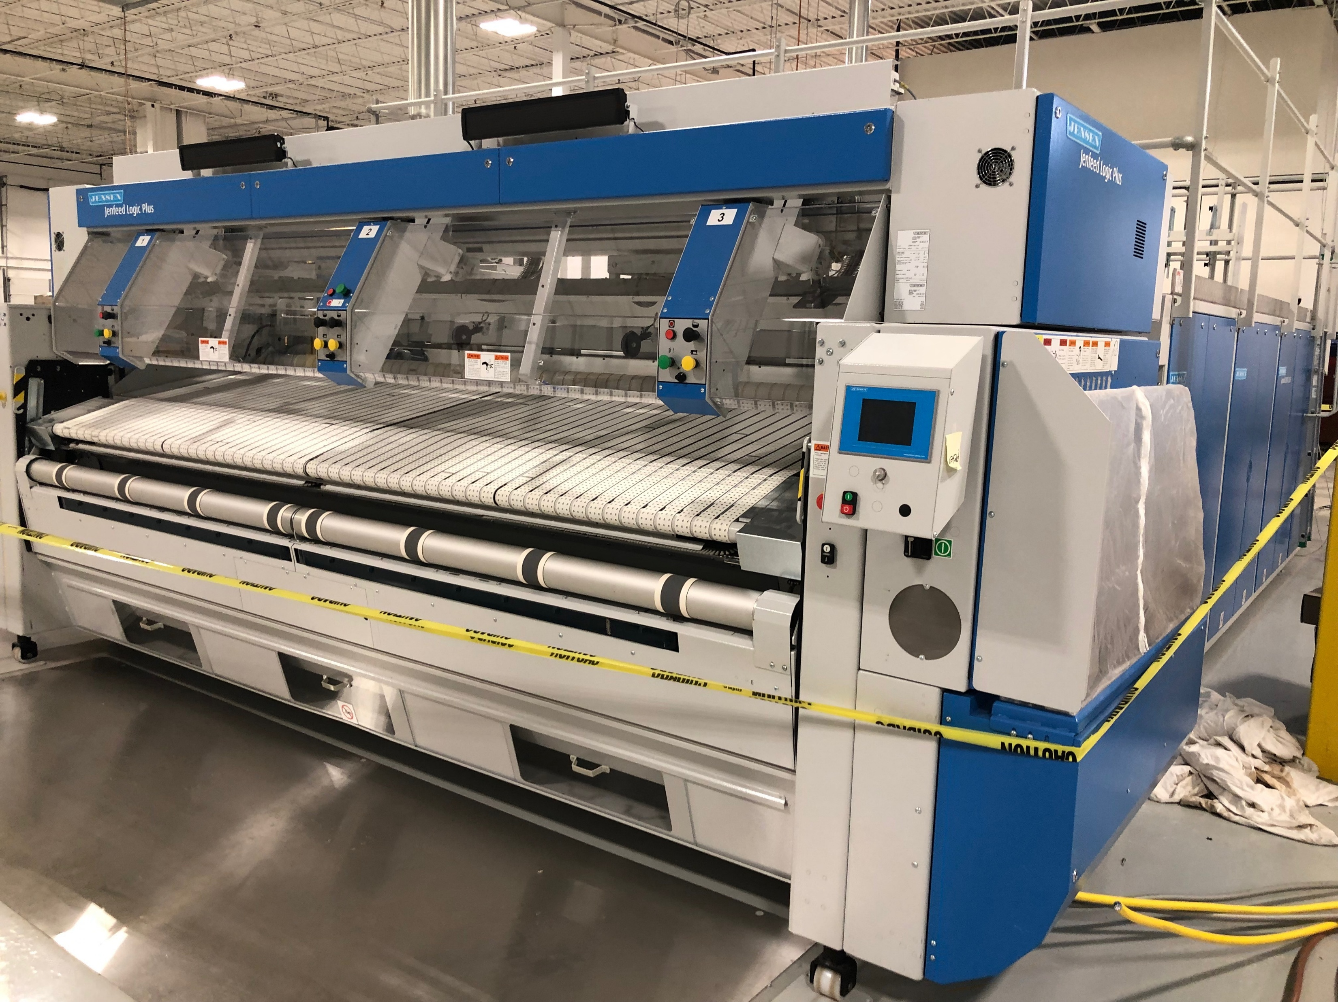
Project Example: Saint Croix Linen
National Objective Met: Low/Mod Jobs (2)
Matrix Code: 18A – ED Direct Financial Assistance to For-Profits
Project Details:
Equipment purchase for business expansion – flatwork commercial ironer (pictured left)
$49,000 CDBG $610,000 total cost

Slide 27

Salt Lake City
Utah’s Capital City
Population: ~217,000
Approx. 110 square miles
Median income $74,925
Major employers: IHC, U of U, Delta
Approx. 95% of businesses in SLC are small businesses (less than 50 employees)
45.5% of Utah employees work for small businesses
Ranked 1ST for best environment for social mobility
Ranked 2nd for friendliest state for small businesses

Slide 28


Salt Lake City's
Neighborhood Business Improvement Program
A deep dive into how CDBG funds revitalize neighborhoods through façade improvement grants.

Slide 29



Program Overview
Program Impact
Established in 2016 with over
$4M invested to date.
Current Operations
Process ~ 60 applications annually.
Transformed approximately 120 commercial properties.
Awards funding to 15 projects each year.
Up to $50,000 grants
Budget growth from
$200K up to
$1.175M annually.

Slide 30
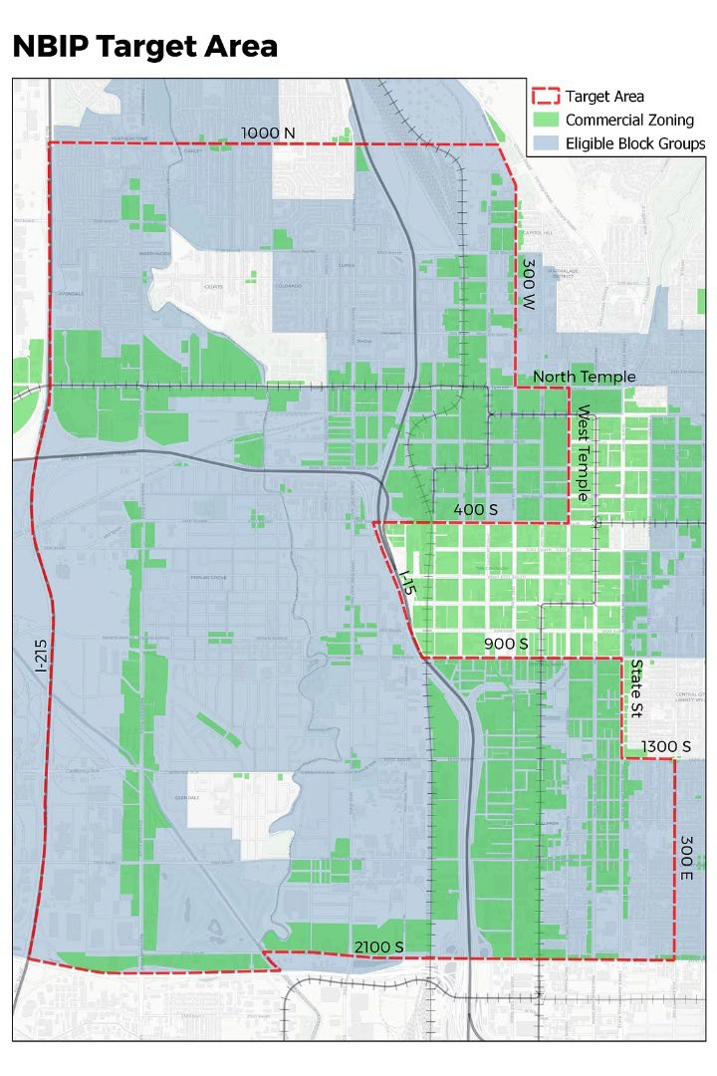
CDBG Requirements
Serve residents in Low-to-Moderate Income Tracts- how is this demonstrated?
Goods & Services
Businesses must demonstrate how they provide essential goods or services to low and moderate-income residents.
Employment Opportunities
Projects can qualify by creating or retaining jobs accessible to low and moderate-income individuals.
Community Service
Activities that benefit the broader community through enhanced access or neighborhood improvement.

Slide 31





Program Setup
Priority Recipients
Minority, veteran, or woman-owned businesses receive preference. ADA accommodations and murals also prioritized.
Selection Process
Competitive application process- reviewed and scored by internal and external stakeholders.
Financial Structure
Up to $50,000 grants available. Participants who contribute 25% of project costs receive priority points. Grant covers remaining 75% of approved renovations (up to $50k).
Implementation
Three-party contracts ensure accountability between business, contractor, and city administration. Sealed bidding process for contractors.

Slide 32

Being Cognizant of Displacement
Façade improvements can inadvertently trigger gentrification pressures. Thoughtful program design protects existing business owners and community character.
Rent Stabilization
Monitor property value increases that could price out existing tenants. Require long-term leases for existing tenants.
Community Ownership
Prioritize locally-owned businesses over chains to maintain neighborhood identity.
Affordable Housing
Coordinate with housing preservation efforts in target improvement areas.
Inclusive Planning
Engage longtime residents in decision-making throughout the improvement process.

Slide 33
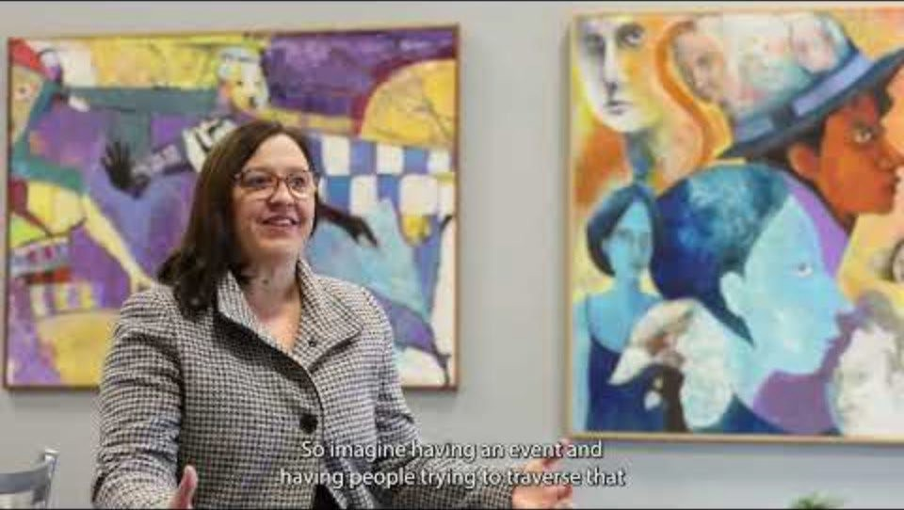
Creating 3rd Spaces
Façade improvements transform commercial corridors into vibrant community gathering places. These investments strengthen social connections and economic vitality.
Well-designed storefronts encourage foot traffic and informal interactions. They create welcoming environments where neighbors naturally connect.

Slide 34
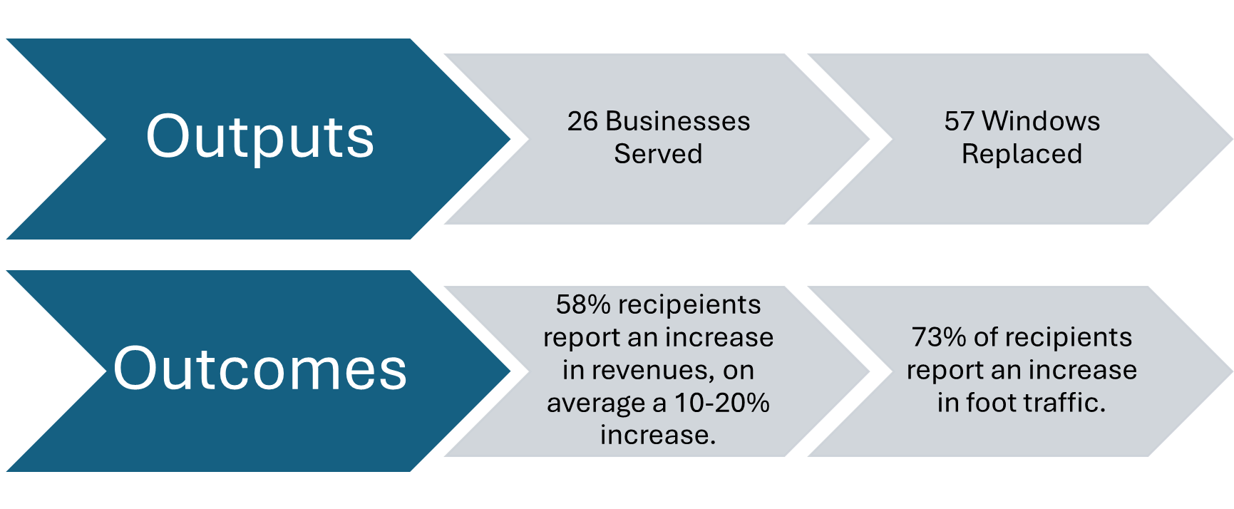
Measuring Program Effectiveness
New paint, doors, windows, and ADA ramp.

Slide 35






Key Lessons Learned
Community Trust
Face-to-face engagement critical for program success
Contractor Management
Performance issues addressed through bonding requirements
Revenue Impact
$25,000-$50,000 average business revenue increase

Slide 36
Patricia’s Hair Salon
Doors, Windows, Paint, and ADA Ramp

Slide 37
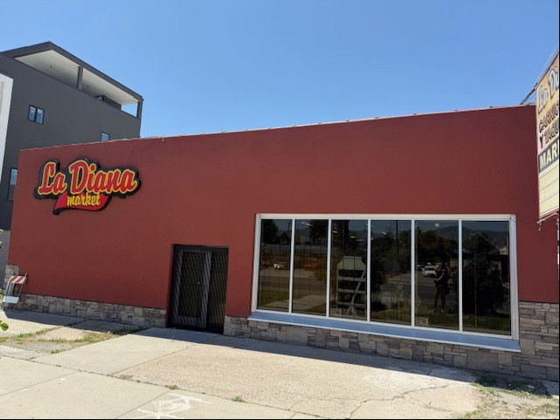
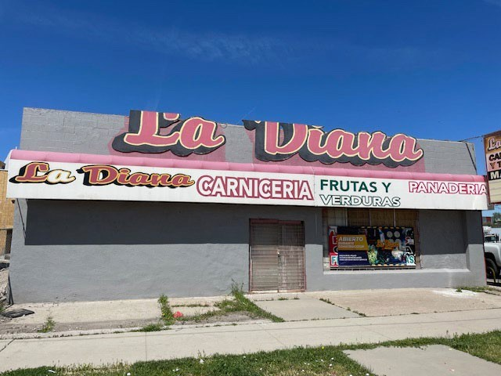
LA DIANA
After
Before
.

Slide 38
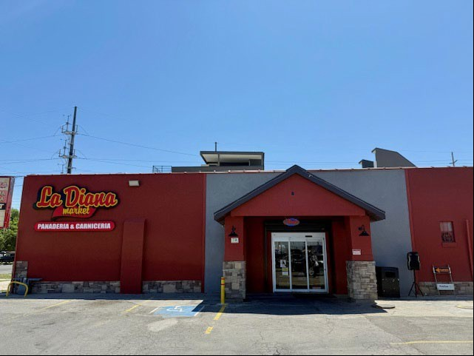
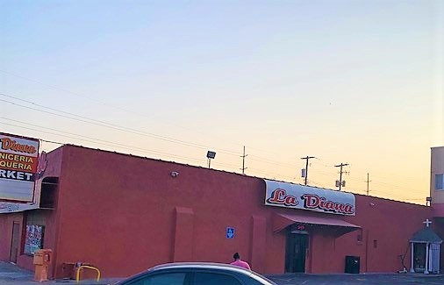
LA DIANA
After
Before

Slide 39
Economic Development Resources
Basically CDBG Chapter 8: Economic Development (HUD Exchange)
CDBG Economic Development Toolkit (HUD Exchange)
Key CDBG regulations related to ED:
24 CFR 570.203 - Special Economic Development Activities
24 CFR 570.209 – Guidelines for evaluating and selecting economic development projects

Slide 40

Questions?

Slide 41
Contact Us
Heather Royall
Salt Lake City Housing Stability Division Heather.Royall@slc.gov
Cell: 385-977-0935
Office: 801-535-7273
Jessica Deegan, Jessica.Deegan@ci.stpaul.mn.us Beth Ulrich, Beth.Ulrich@ci.stpaul.mn.us
Department of Planning and Economic Development
City of St. Paul, MN

